Slide 1
CO 2
Session no. 21

Slide 2
Dynamic Host Configuration Protocol (DHCP)
The Dynamic Host Configuration Protocol (DHCP) is a network management protocol used on Internet Protocol (IP) networks, whereby a DHCP server dynamically assigns an IP address and other network configuration parameters to each device on the network, so they can communicate with other IP networks.
A DHCP server enables computers to request IP addresses and networking parameters automatically from the Internet service provider (ISP), reducing the need for a network administrator or a user to manually assign IP addresses to all network devices.
In the absence of a DHCP server, a computer or other device on the network needs to be manually assigned an IP address.

Slide 3
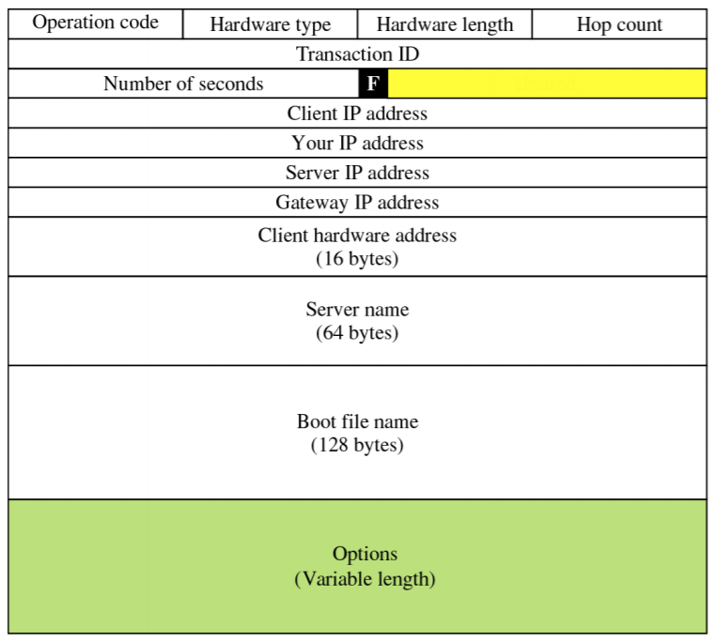
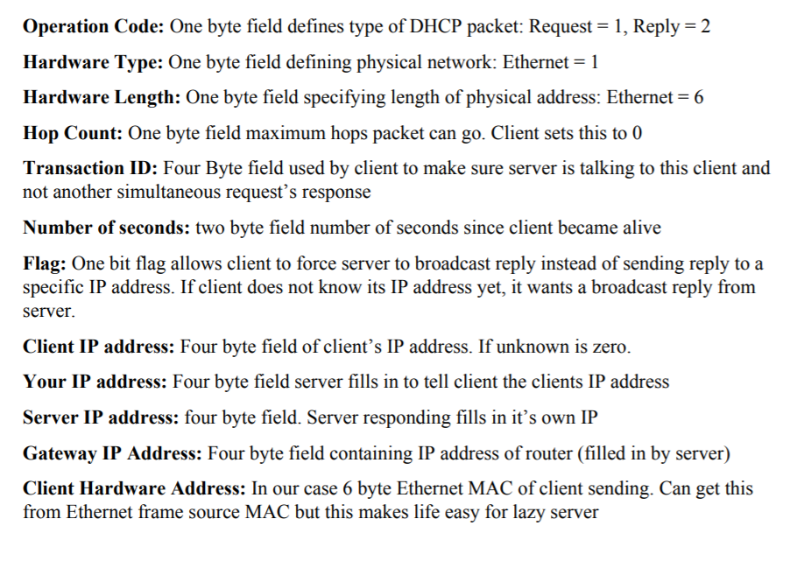
DHCP message format

Slide 4
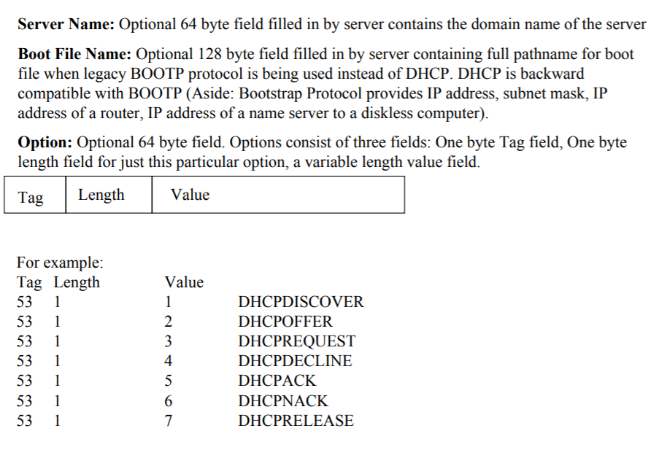

Slide 5
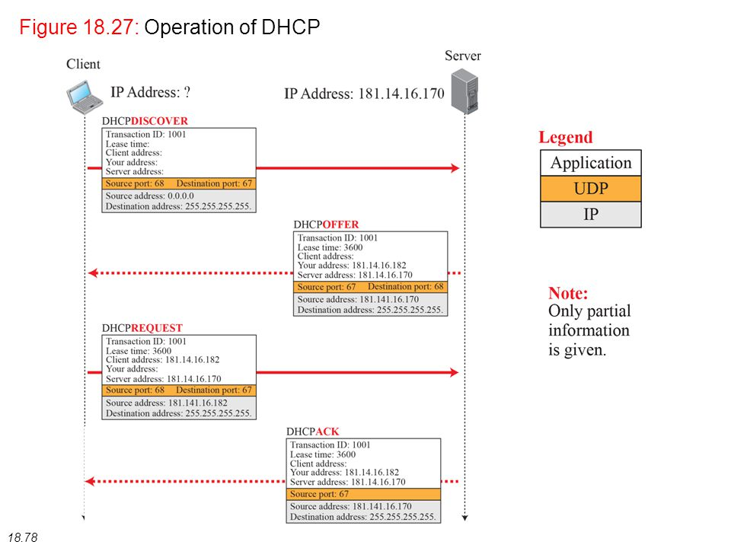

Slide 6
DHCP
DHCP (Dynamic Host Configuration Protocol) is a protocol used to provide quick, automatic, and central management for the distribution of IP addresses within a network. DHCP is also used to configure the proper subnet mask , default gateway, and DNS server information on the device.
Need
IP addresses can be configured statically or dynamically. Normally we configure static IP addresses on network devices like routers, switches, firewalls and servers while we dynamically assign IP addresses to computers, laptops, tablets, smart phones etc. It is an application layer protocol.

Slide 7
DHCP Messages
DHCPDISCOVER
The first time a DHCP client computer attempts to log on to the network, it requests IP address information from a DHCP server by broadcasting a DHCP Discover packet.
It is a broadcast message where the source IP address in the packet is 0.0.0.0 because the client does not yet have an IP address and the destination address is 255.255.255.255.
DHCPOFFER
Each DHCP server that receives the client DHCP Discover packet responds with a DHCP Offer packet containing an unleased IP address and additional network configuration information, such as the subnet mask and default gateway.
More than one DHCP server can respond with a DHCP Offer packet. The client will accept the first DHCP Offer packet it receives.
DHCPREQUEST
When a DHCP client receives a DHCP Offer packet, it responds by sending a DHCP Request packet that contains the offered IP address, and shows acceptance of the offered IP address
DHCP Acknowledge (DHCPAck)
The DHCPACK message is an acknowledgement by the DHCP server that authorizes the DHCP client to start using the network configuration it received from the DHCP server earlier.

Slide 8
DHCPNAK
This message is the exact opposite to DHCPACK described above. This message is sent by the DHCP server when it is not able to satisfy the DHCPREQUEST message from the client.
DHCPDECLINE
This message is sent from the DHCP client to the server in case the client finds that the IP address assigned by DHCP server is already in use.
DHCPRELEASE
A DHCP client sends a DHCP Release packet to the server to release the IP address and cancel any remaining lease.

